Slide 1
Computers & Society
Hyland Hy-Tech Camp

Slide 2
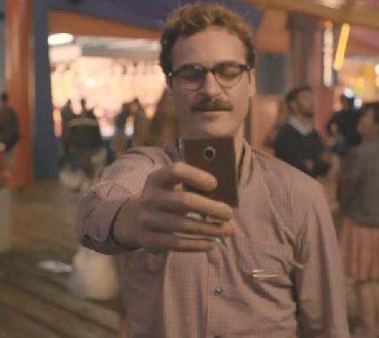
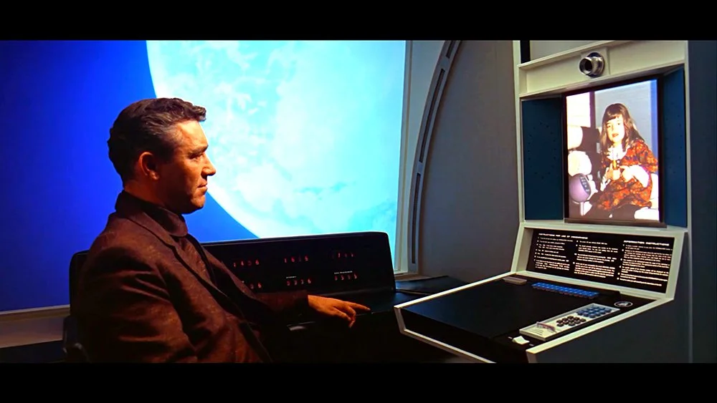
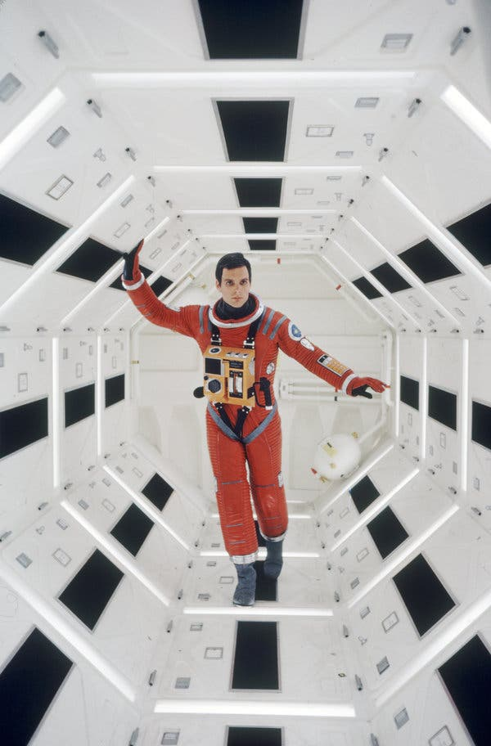
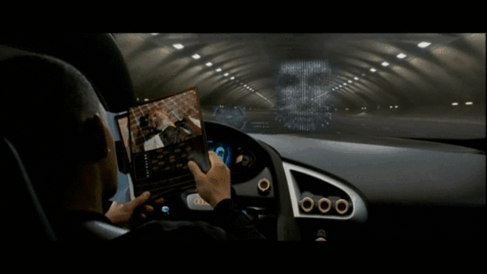
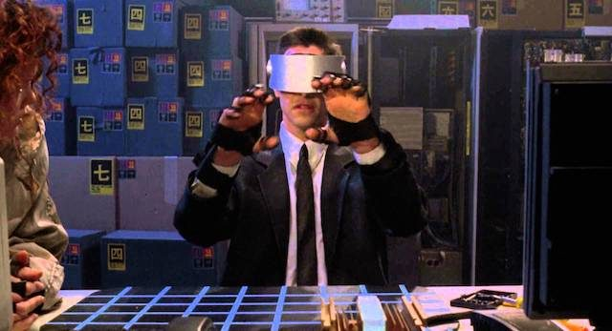
Science Fiction v. Science Itself
Notes:
Ask the students to give examples of science fiction
Note that some ideas that were once science fiction have become a reality:
Video Calls
Self-Driving Cars
A.I. Powered Voice Assistants
Virtual Reality
Space Stations
Ask the students if they recognize where any of these originate:
Video Calls + Space Station – 2001: A Space Odyssey
Self-Driving Cars – I, Robot
A.I. Powered Voice Assistant – Her
Virtual Reality – Johnny Mnemonic
Note that we will explore the impact of these technologies in this presentation

Slide 3
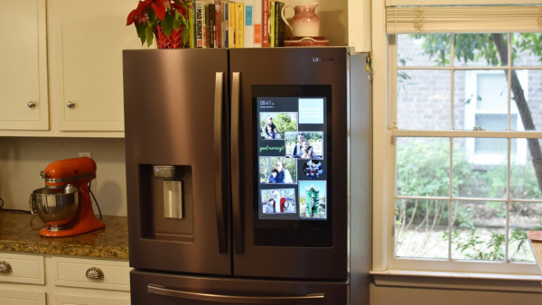
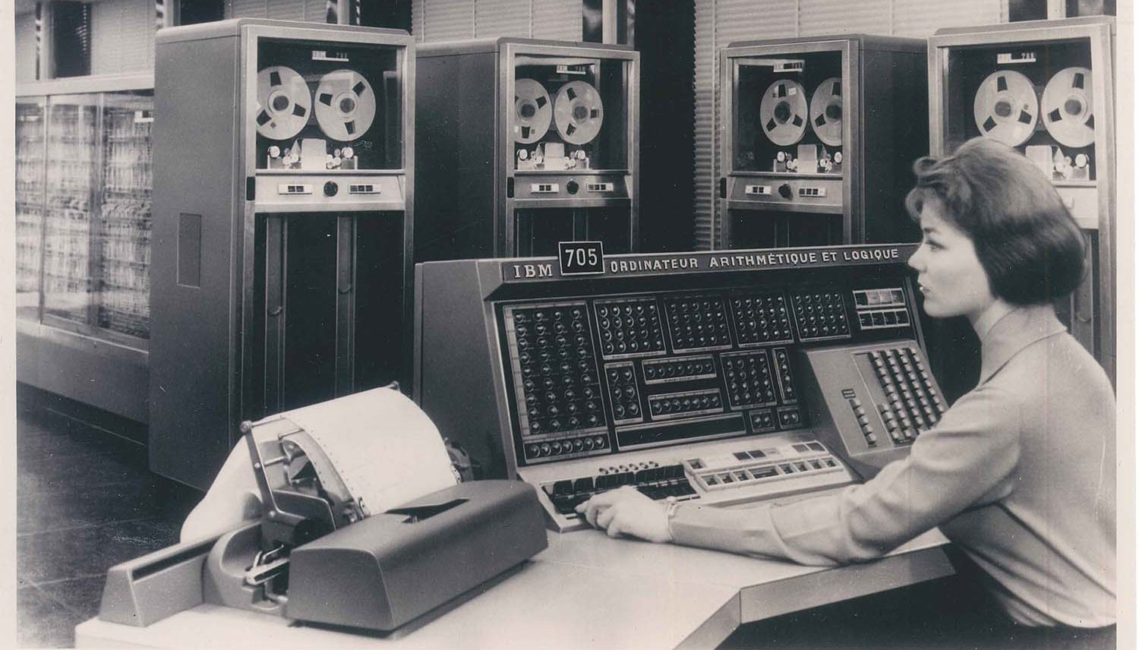
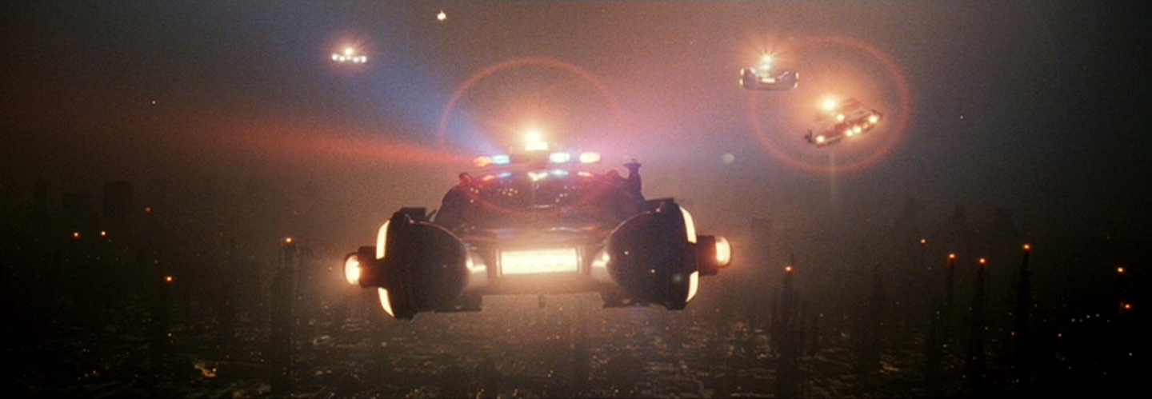
Camp Agenda
Past
How did we get here?
How have computers and other technologies had an impact on society throughout history?
Present
Where are we exactly?
What computer technologies are currently having an impact on society?
Future
Where are we going?
How will emerging technologies enter the mainstream?
What hypothetical technologies could become a reality?
Notes:
Go through the basic sections this presentation will contain
Make sure to note that this camp will only scratch the surface of the history, present day, and potential future of computing technology
We will start with the past – note how far we have come since the early days of computers
We will then move onto the present – we will discuss current technologies and how they are changing things in the world (like having tv screens on fridges)
Then, we will look forward to the future – maybe we will end up living in a dystopia like in Blade Runner (but maybe not)

Slide 4
Computers in History
How have computers had an impact on us?
Notes:
We will begin by discussing some (keyword: some) of the history of computers

Slide 5
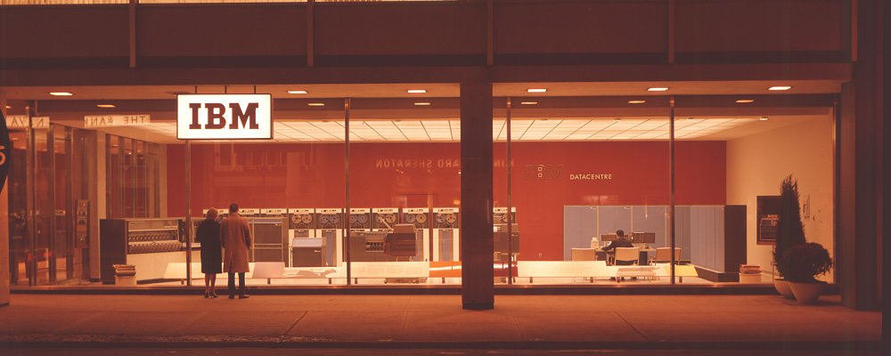
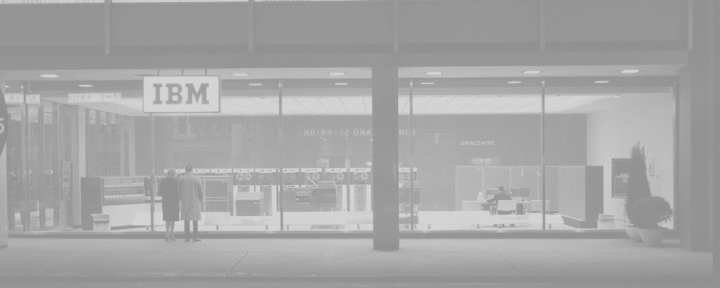
Early Days of Computers
Giant, complex calculators for science
Various military and academic applications – research and codebreaking
(A.I.) started to take shape in earnest in the 1950s
Artificial Intelligence
Notes:
No need to spend too long on this slide…
Show the picture of an IBM Data Center, from Toronto 1963
Talk about how originally, computers were basically just giant calculators used for scientific and engineering equations
In the beginning, most applications were for the military (like code-breaking) or for academic studies
In the 1950s, the field of A.I. was born
https://www.computerhistory.org/timeline/computers/

Slide 6
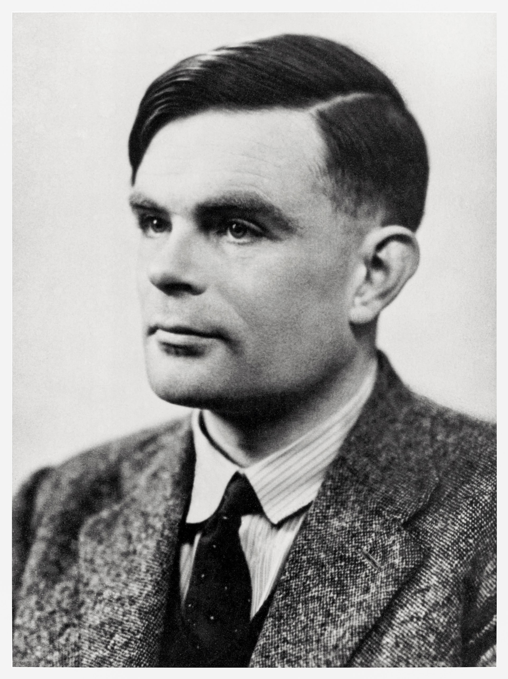

Artificial Intelligence
in History
The Turing Test – can a person tell a computer from a human?
Can a machine actually become conscious?
Will an A.I. ever be as intelligent as a human?
Is the human mind a physical thing?
Can a machine think?
Alan Turing
Notes:
Alan Turing was known as the “father of artificial intelligence”
Seriously recommend reading more about him, he is an incredibly impactful and interesting person
One of his contributions to the field was the “Turing Test” – a way to measure how “intelligent” an artificially intelligent agent actually is
This involves a judge having a conversation via text with two “people” – one, a real person, and the other, a computer
If the computer can successfully fool the judge, it has passed the test!
Poll the students with this question: “Can a machine think?”
Have them put up fingers or answer in the Zoom chat:
1 for yes
2 for no
3 for maybe/not sure/depends
Poll the students in the same way with the following questions
Can a machine actually become conscious?
Will an A.I. ever be as intelligent as a human?
In this case, it means generally intelligent, i.e. able to solve any problem a human can solve
Is the human mind a physical thing?
https://plato.stanford.edu/entries/turing-test/
https://plato.stanford.edu/entries/chinese-room/

Slide 7
Practical Applications
Through the 40s, 50s and 60s, computers evolved into general-purpose machines that became commercially available
They were used in business to automate tasks, manage data, and produce reports.
"There is no reason anyone would want a computer in their home.“
Ken Olson
1977
Notes:
No need to spend too long on this slide…
Now let’s move away from the philosophical and into the practical. How were computers actually used in this era?
Talk about the evolution of computers – they started being used more widely. Still mostly academic and military
Big business also started adopting the use of computers though, for a variety of purposes
Still, at this time, computers were only really used by researchers or highly technical people in specific fields… they were not commercially available to the general public. To sum that up, show the quote from Ken Olson
Note, it’s kind of apocryphal, even though he did really say it: https://www.snopes.com/fact-check/ken-olsen/
Smash cut to…
https://www.computerhistory.org/timeline/computers/

Slide 8
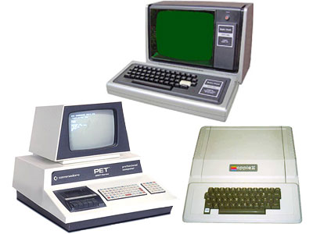
– The Personal Computer
1977
What’s Changed?
Original “PC” Functions
Primitive video games
Word processing
Spreadsheets
Data access/storage
Education
Graphics and Animations
Music composition
General programming
Notes:
No need to spend too long on this slide, other than the discussion portion
The year: 1977. Three very important computers were released this year, that would be dubbed the “Trinity”
Commodore PET (students probably won’t recognize this company)
Apple II (students should recognize this company)
TRS-80 (students might recognize Radio Shack?)
These three computers were the first successful mass-market personal computers – they were “affordable” and “usable”
What could they do? (Ask the students if they have any ideas)
Basic video games (with minimal graphics)
Word processing – very primitive version of something like Microsoft Word
Spreadsheets like Microsoft Excel
Database applications
Used to teach students about computers and programming
Could create graphics and animations
Could be used to compose music
Could be used for general programming – there was a ton of interesting and home-brewed software out there!
After going over some of the basic capabilities, ask students how computers now are different

Slide 9

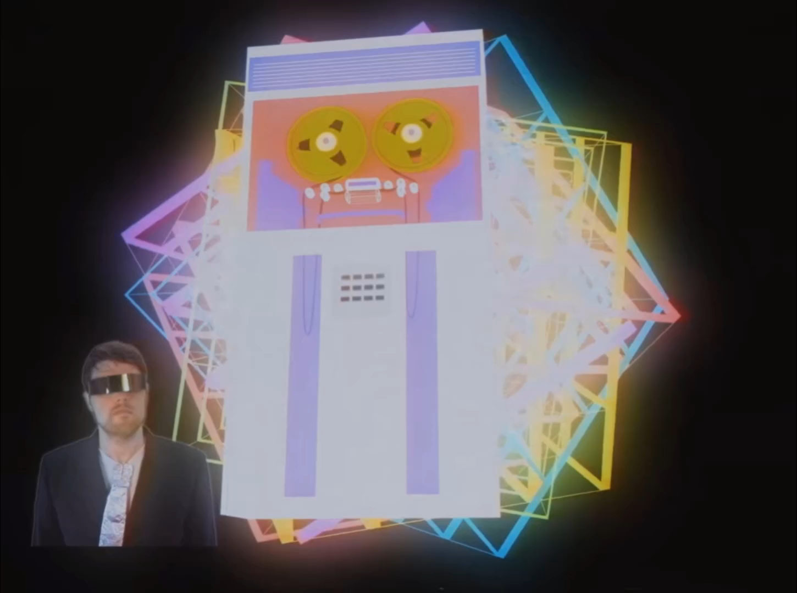



The Internet (World Wide Web)
Web 1.0
read-only, content created by “admins”
Web 2.0
social web, content created by users
Web 3.0
decentralized web
Notes:
One of the biggest advancements since 1977 is the World Wide Web, or what we know as “The Internet”
Play the video introducing the idea of the internet
Go over Web 1.0 – the first iteration of the web that was “read-only” – content had to be created by those with the means and knowledge to create it. Most users were simply consumers. Mostly static HTML pages rather than dynamic
Go over Web 2.0 – now, pretty much anybody is able to create and share content on the web (Myspace, YouTube). Here, the content was dynamic, the user experience was rich and enveloping, and there was mass participation. It wasn’t only dweebs on the web anymore.
Ask the students if they recognize the logos
Ask the students to name other social media
Briefly touch on Web 3.0 – decentralized ownership of the internet

Slide 10
The Internet
Good Things
Connections to people
Easier to share things
Remote education
Memes
Streaming TV
Bad Things
Radicalization
Misinformation
Privacy Concerns
Crime
Social Media Addiction
Notes:
Ask the students what positive impacts the internet has had on the world
After a discussion, reveal some examples of “good” things
Ask the students what negative impacts the internet has had on the world
After a discussion, reveal some examples of “bad” things

Slide 11
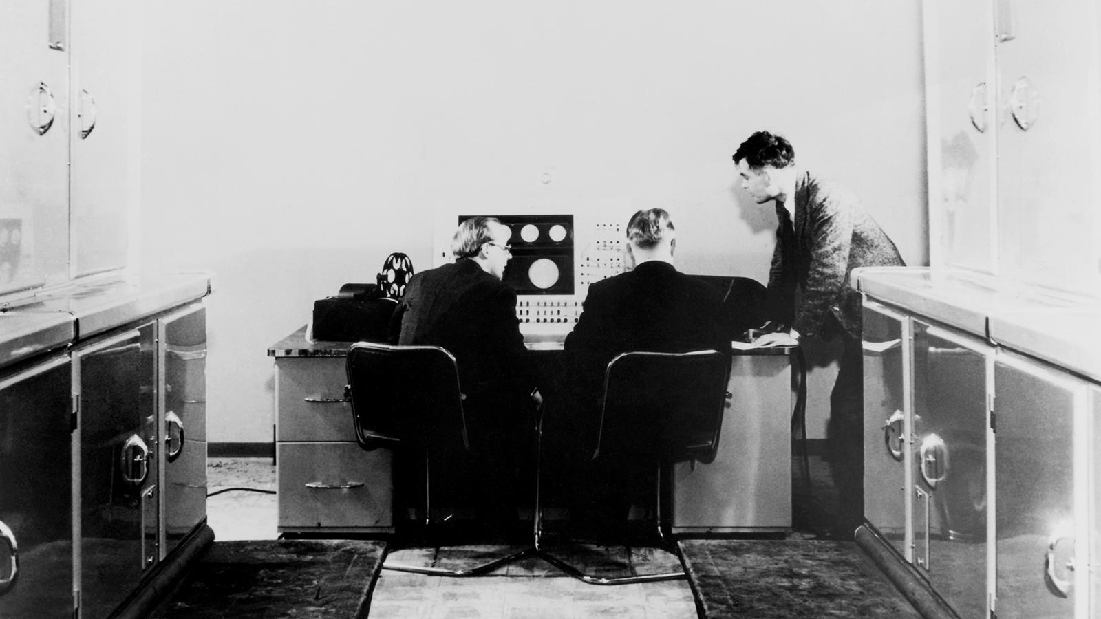
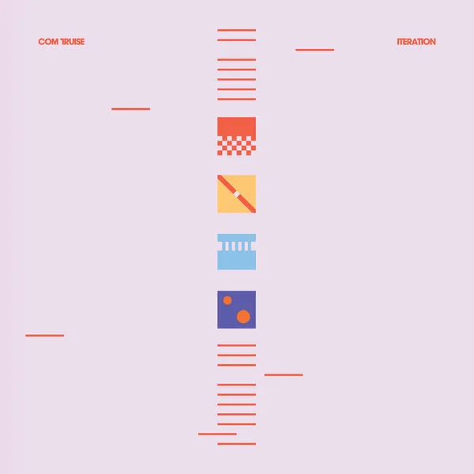
Arts & Entertainment
Electronic Music
from this:
to this:
Notes:
Ask the students how computers have impacted arts and entertainment
s
https://www.bl.uk/collection-items/earliest-known-recording-of-computer-generated-music

Slide 12
Ethics
Ford Pinto case https://philosophia.uncg.edu/phi361-matteson/module-1-why-does-business-need-ethics/case-the-ford-pinto/
Notes:
Play the video introducing the idea of the internet

Slide 13
Moore’s Law
Synthy music
CGI
Pixar
Notes:
Play the video introducing the idea of the internet

Slide 14
Computers in the Present
How do computers impact us today?
Notes:
We will continue by discussing some (keyword: some) of the ways computers impact the present day

Slide 15
Computers are Everywhere
What is a computer?
How have smart phones changed the world?

Slide 16
CoViD-19
Zoom, digital divide

Slide 17
Current State of A.I.
Self-Driving Cars
Deep Learning
Machine Learning ethics (algorithmic bias)
Deepfakes

Slide 18
Deepfakes
Kendrick Lamar
Obama
Misinformation
Synthesia

Slide 19
Blockchain
Cryptocurrency – good and bad
NFTs – good and bad

Slide 20
Non-Reality Reality
VR, AR, metaverse

Slide 21
3D Printing
Medical applications
Food, clothing, cars, houses
GUNS?!!

Slide 22
Internet of Things (IoT)
Smart home
Security concerns
Potential for… death

Slide 23
Brain-Computer Interface
This is already happening

Slide 24
Computers in the Future
How will computers impact us tomorrow?

Slide 25
Types of Future Technologies
Emerging
Hm
Hm
Hm
Hypothetical
Hm
Hm
Hm
Examples
$50 | 400 kilograms | 2.9 gpa
240 films watched | 91.9 seconds
Examples
grade level | hair color | gender
city name | material type
Notes:
Data can come in many different forms, but two of the most basic ones are numerical and categorical
Numerical data is data in the form of numbers
It is quantitative
Arithmetic Operations can be performed on it
Show the students some examples of numerical data, and ask if they have any more
Categorical data is data based on groups
It is qualitative (students may be able to guess this)
There is no specific mathematical meaning
Show the students some examples of categorical data, and ask if they have any more

Slide 26
The Future of A.I.
Government by algorithm
A.I. political candidate
“Split Up” software
Technological Unemployment
Paperclip maximizer
Superintelligence
Singularity
Movies generated by A.I. (deepfakes)
Notes:
Er
Ok

Slide 27
The Future of Non-Reality
What if we are living in a simulation
Allegory of the Cave
Hyperreality
Notes:
Er
Ok

Slide 28
Quantum Computing
DEVS
Faster computing
Other things

Slide 29
More Topics – Hypothetical
Whole-Brain Emulation
Mind-Uploading
Digital Immortality
Santa Claus Machine
Nanocomputer
Self-replicating Spacecraft

Slide 30
Summary
Wrapping things up

Slide 31
Summary
Past
Primitive computers, A.I., the internet, and other digital technology has impacted our culture, economy, and society
Present
Current computer technologies like smart phones, A.I., blockchain, VR, and more continue to impact society
Your Impact
As a member of Gen Z (aka a Zoomer), you will have the opportunity to work with new technologies and shape the future of our world
Future
Emerging technologies and hypothetical technologies will have an impact on society as they evolve
Notes:
Go through a brief summary of the presentation
Talk about how computers have impacted society in the past
Ask the students for examples
Ask the students for a take-away about computers in the past
Talk about how computers currently impact society
Ask the students for examples
Ask the students for a take-away about computers in the present
Talk about how computers and new tech will impact society in the future
Ask the students for examples
Ask the students for a take-away about computers in the future
Emphasize that the students themselves will be the ones who will really have the opportunity to work with these new technologies - their generation will be the one that has the biggest impact

Slide 32
THANK YOU!
WHAT QUESTIONS DO YOU HAVE?

